Slide 1
SOCIAL BEE
A social network for your own community

Slide 2
Why Social Bee ?
Well not everyone knows every individual in other social networking sites.
Provides a platform to create a social network for your own community.
Limited access to individuals.
High scalability

Slide 3
DATA FLOW DIAGRAM

Slide 4
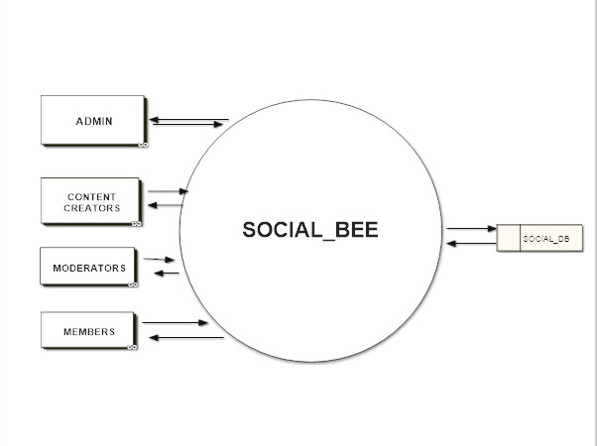
LEVEL O

Slide 5
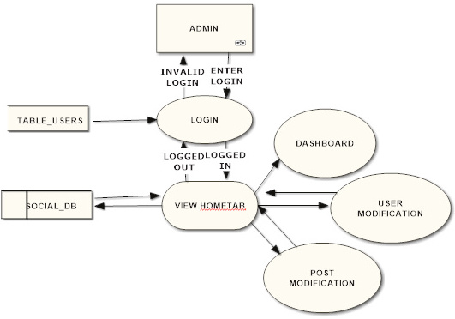
level 1 (admin)

Slide 6
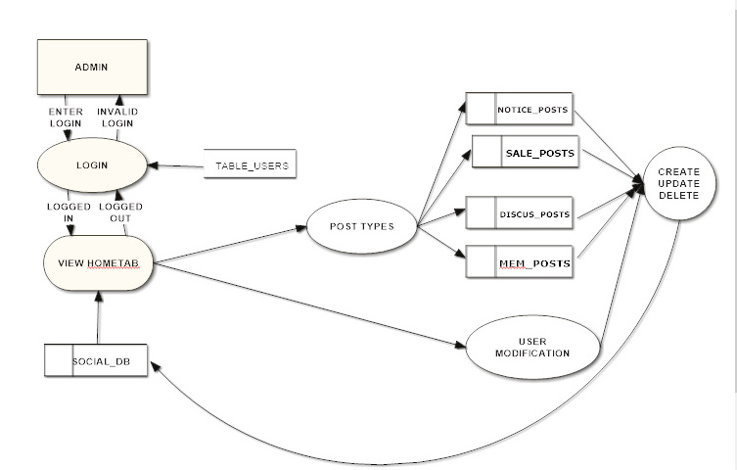
level 2(admin)

Slide 7
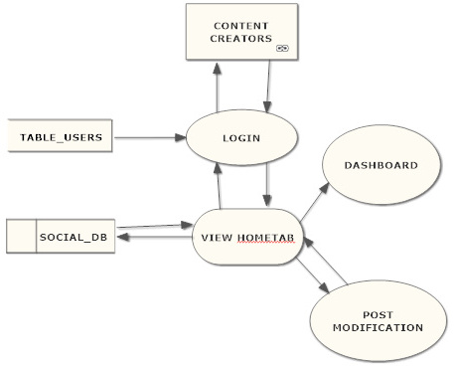
level 1 (cont. creator)

Slide 8
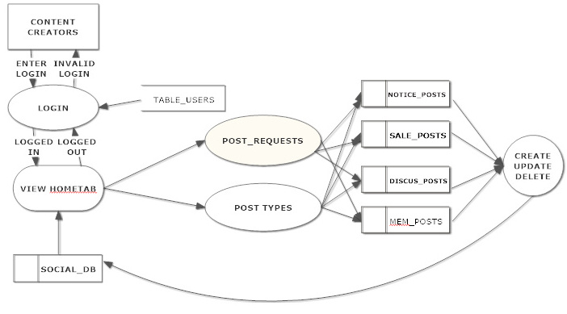
level 2 (cont. creator)

Slide 9
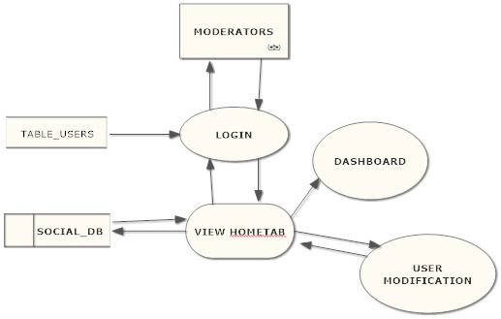
level 1 (moderator)

Slide 10
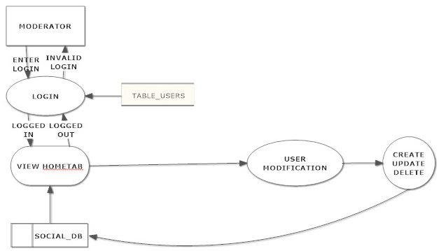
level 2 (moderator)

Slide 11
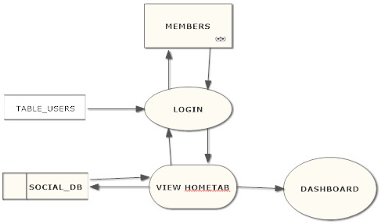
level 1 (members)

Slide 12
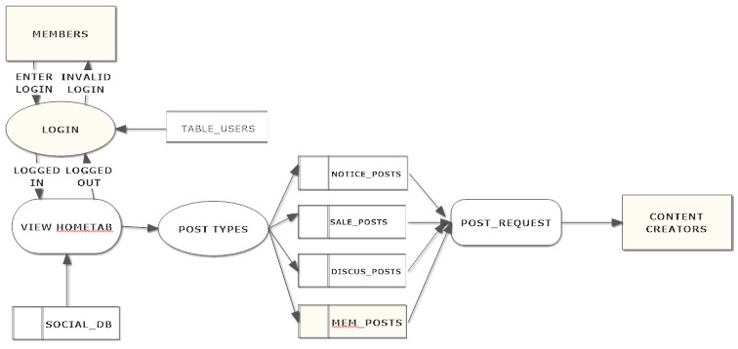
level 2 (members)

Slide 13
DB structure

Slide 14
REGISTRATION TABLE
field_name | data_TYPE
User_id | int(PK)Auto-INCR
fullname | varchar
collegename | varchar
dob | date
emailid | varchar
User_name | varchar(UNIIQUE KEY_FK_tb_login_tbl)
password | varchar
Mobileno | integer
POST TABLE
field_name | data_TYPE
Post_id | int(PK_Auto-INCR)
Post_parent_id Post_type | Int(FK_tbl_post_post_id) Varchar(FK_tbl_post_type)
Created_time | Datetime timestamp
Updated_time | datetime
Created_by | Varchar(FK_user_name_user_table)
Updated_by Post_content | Varchar(FK_user_name_user_table) BLOB

Slide 15
LIKE HISTORY TABLE
field_name | data_TYPE
Post_id | int(FK_tbl_post)
like_id | int(PK_Auto-incr)
Liked_user_name | Varchar(FK_tbl_usr)
Like_time | Datetime Timestamp
COMMENT HISTORY TABLE
field_name | data_TYPE
Comment_parent_id Post_id | Int(FK_comment_id) int
Comment_id Message Created_timestamp Updated_timestamp Created_by Updated_by Like_count | Int Varchar Datetime Timestamp Datetime Varchar(FK_user_name_user_table) Varchar(FK_user_name_user_table) int

Slide 16
SUBSCRIBE TABLE
field_name | data_TYPE
postid | int(FK_tbl_posts)
User_id | Int(FK_tbl_reg_table)
NOTIFICATION TABLE
field_name | data_TYPE
postid | integer(FK_tbl_posts)
Notification_message Created_by | Varchar Varchar(FK__user_name_user_table)
Created_timestamp isread | Datetime Timestamp boolean
POST_TYPE TABLE
field_name | data_TYPE
Post_type | varchar

Slide 17
USER_TYPE TABLE
field_name | data_TYPE
user_type | varchar
LOGIN TABLE
field_name | data_TYPE
user_name | varchar(UNIIQUE KEY)
password | Varchar
User_type | varchar

Slide 18
LAYOUT: Homepage

Slide 19
LAYOUT: Signup

Slide 20
LAYOUT: Login

Slide 21
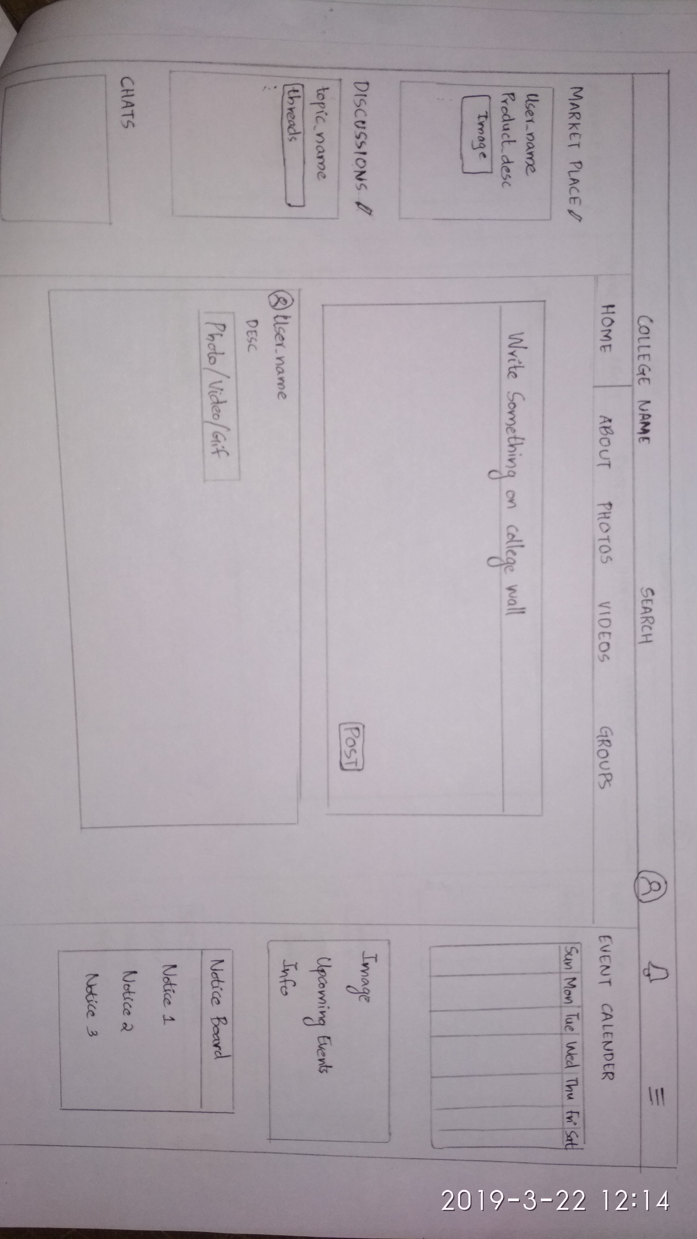
HOME TAB

Slide 22
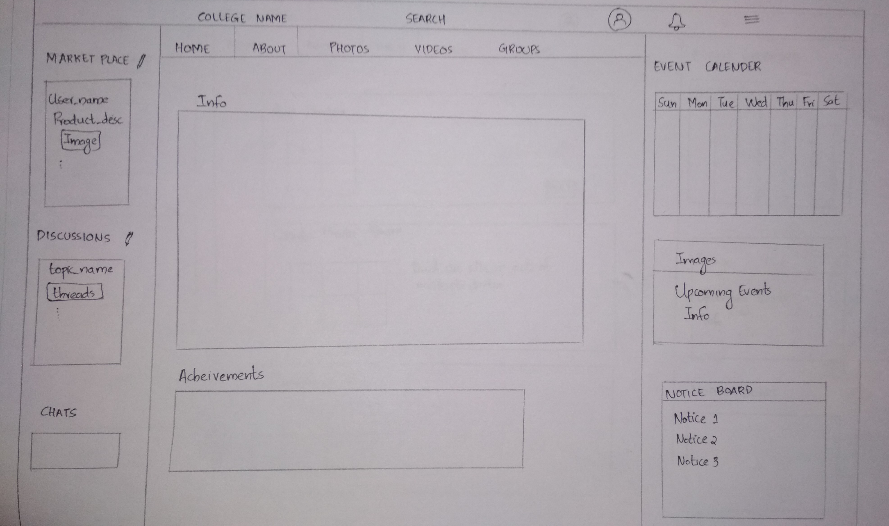
ABOUT TAB

Slide 23
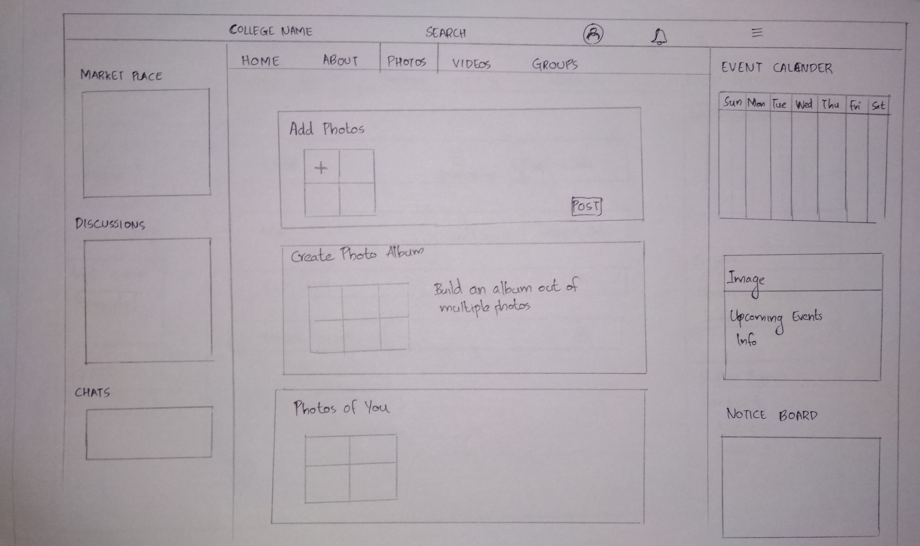
PHOTOS/VIDEOS TAB

Slide 24
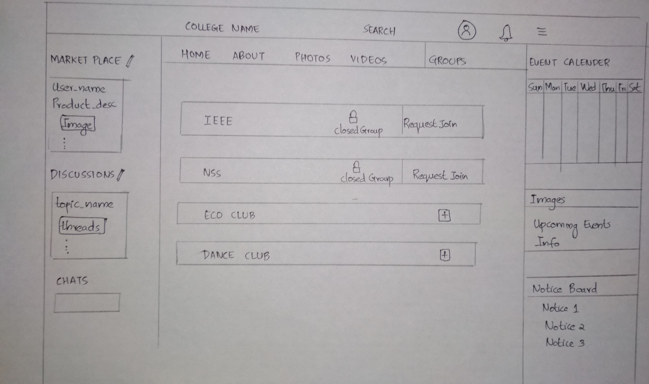
GROUPS TAB

